Slide 1


Bitwarden Password Manager
John McGinnes
011700043
D339: Technical Communication (WGM2)
Notes:
Create a title for your presentation that reflects your technology topic. This would be considered Slide #1 of at least 5 slides in your presentation.

Slide 2

Agenda
In this presentation, we will discuss:
The details of Bitwarden and how it ensures password security and creates easy password storage.
How Bitwarden could potentially avert disastrous security breaches and avoid the risk of lawsuits or non-compliance.

Slide 3
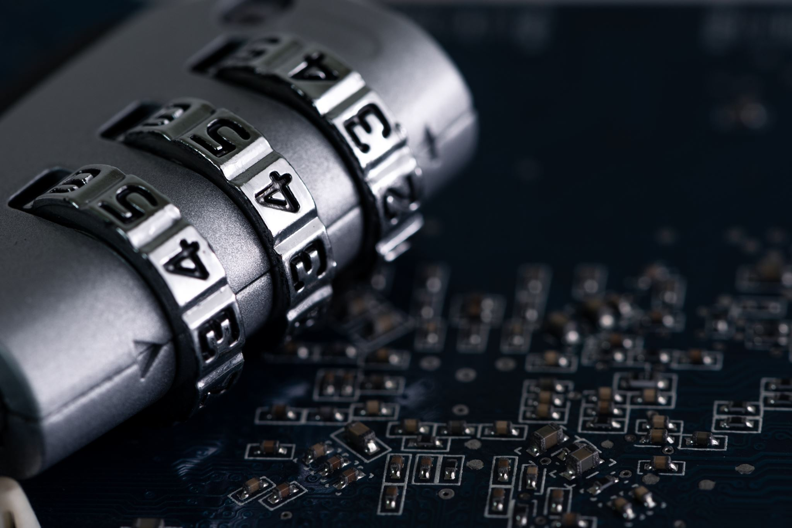
What is Bitwarden and how does it work?
Bitwarden is a cross-platform password manager designed to provide secure storage for a sensitive information including not only passwords, but usernames and personal identifiers.
This information can be accessed from the Bitwarden application using a user-created master password.
This master password is secured using the gold standard encryption algorithms AES-CBC 256-bit encryption, salted hashing, and PBKDF2 SHA-256(Bitwarden, n.d.a).
Using these methods, you are the only person who will be able to use your master password to access your vault. It is not recoverable by email or the Bitwarden employees.

Slide 4
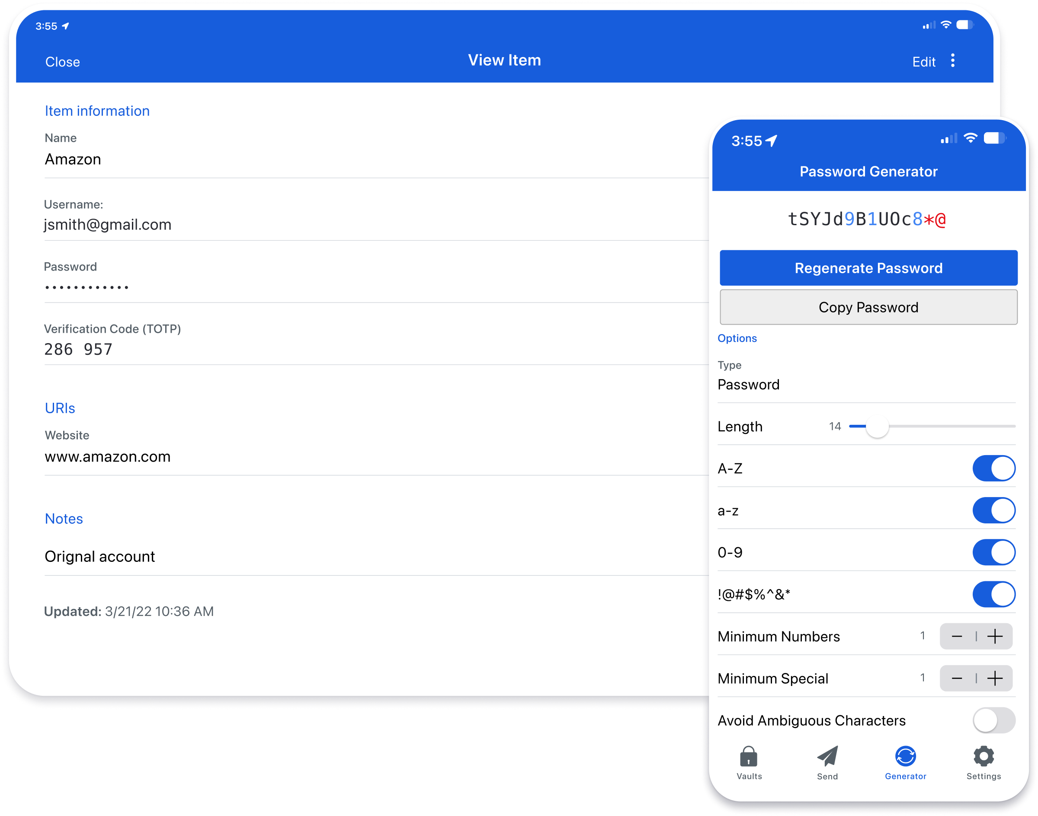
BitWARDEN FEATURES
Bitwarden provides useful tools, such as a random password generator.
The password generator lets you choose the length, special character, and capital letters requirements.
Using this tool creates stronger passwords by avoiding the use of common passwords themes (dates, pet names, etc.)
Image Credit: (Bitwarden, n.d.b)

Slide 5
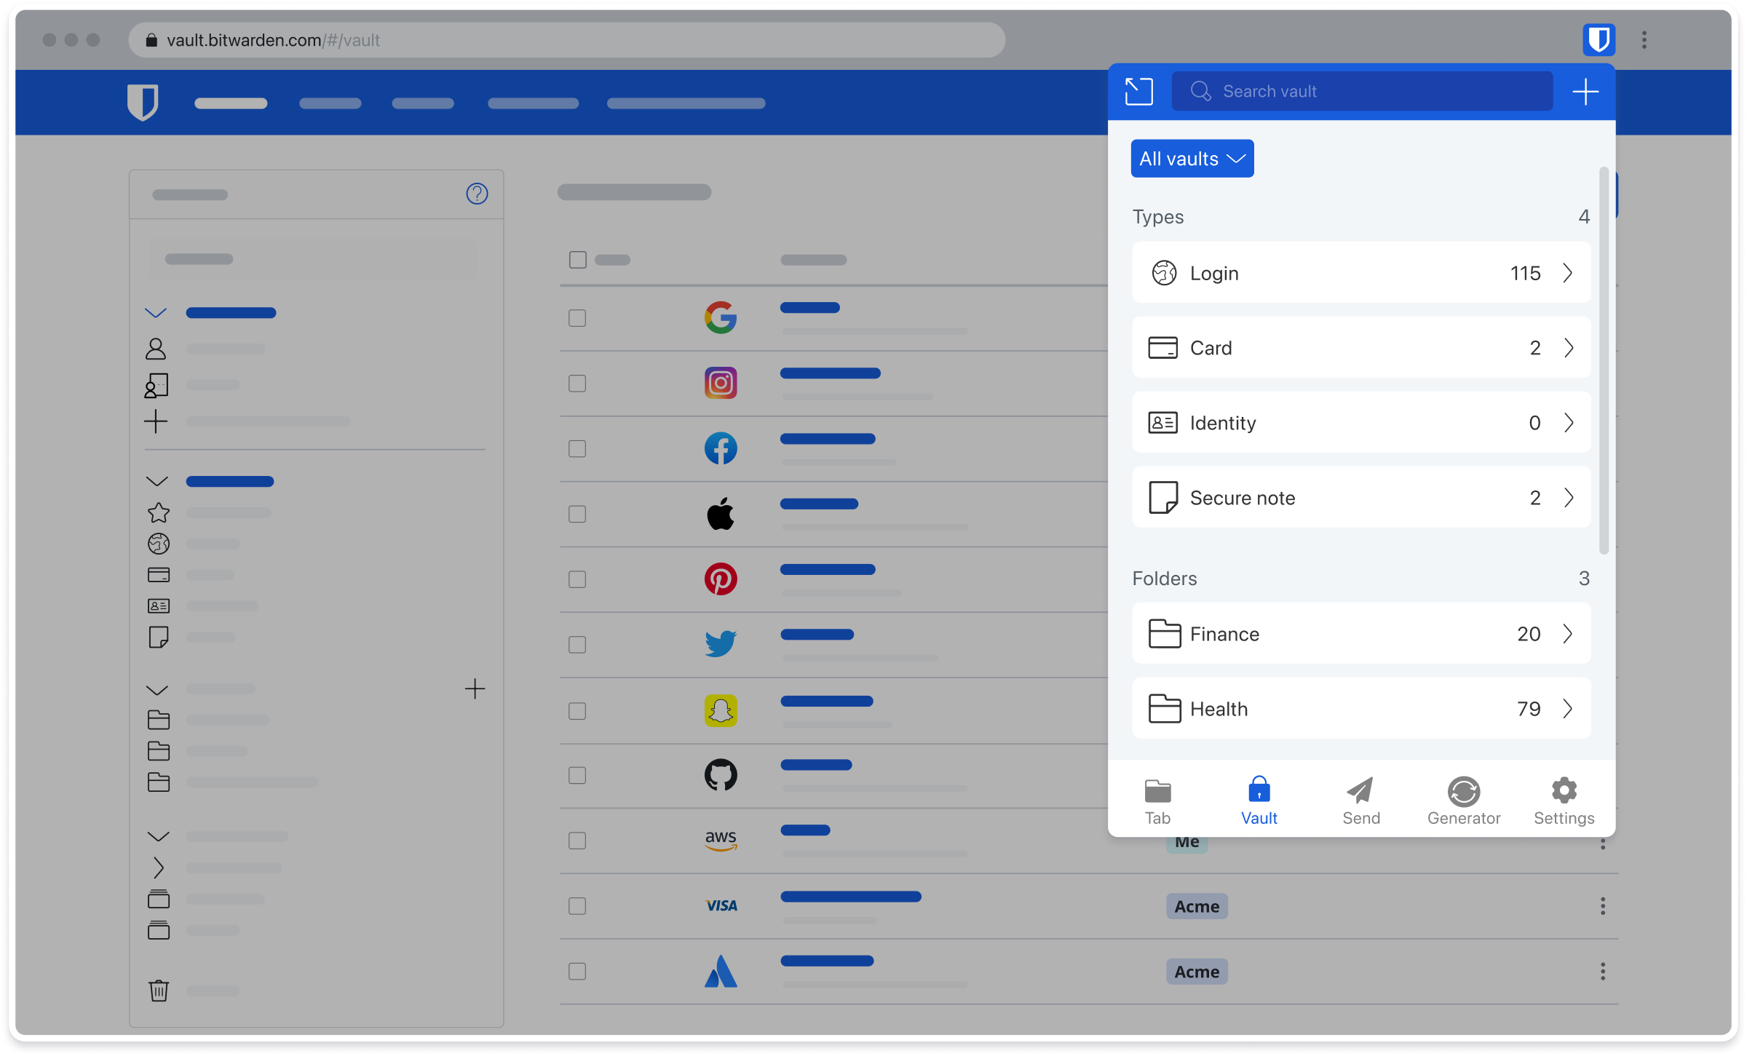
Browser extensions & Sharing
All versions of Bitwarden also include browser extensions. These can be used to Auto-fill passwords within your browser.
In addition, the application provides a secure way to share passwords if needed.
Image Credit: (Bitwarden, n.d.b)

Slide 6
Benefits of the Technology to Our Company
Provides a secure password storage solution for our users.
Encourages users to create stronger passwords.
Prevents potential risks related to password breaches, helping to avoid lawsuits, non-compliance, or loss of reputation.

Slide 7
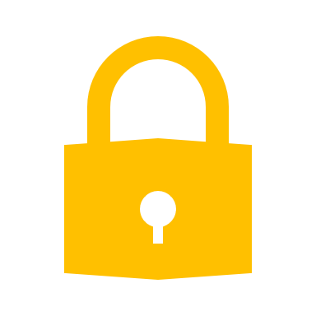
References
Bitwarden (n.d.a). What Encryption is Used?
https://bitwarden.com/help/what-encryption-is-used/
Bitwarden (n.d.b) Press Room
https://bitwarden.com/resources/press-room/

